Slide 1
Facebook – Privacy Incident 2015
Problem – User data could be harvested
Zankruti Desai

Slide 2
History of Facebook
Founded By Harvard student Mark Zuckerberg in Febuary 2004 and was named thefacebook
In 2005 the thefacebook was officially called Facebook. It could be accessed only if the person has a valid college email id and it was later extended for high school students.
In September 2006 - open enrollment.

Slide 3
Social Network and Privacy
Relationship between a person’s social network and privacy can be multi-factored
In some cases, users want their information to circulate throughout smaller online communities and not to strangers
In others, users will be willing to open their private information to strangers.

Slide 4
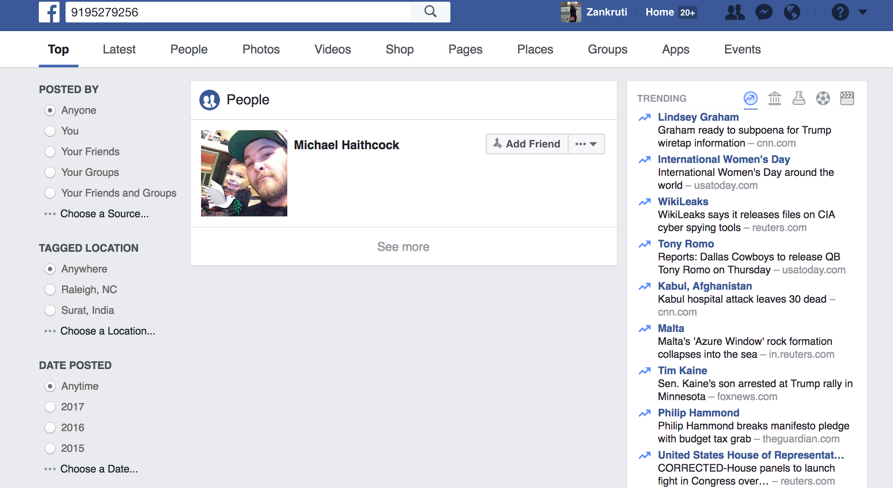
Issue
If mobile number is known then we can search for that person on Facebook
Default setting – Everyone/Public

Slide 5
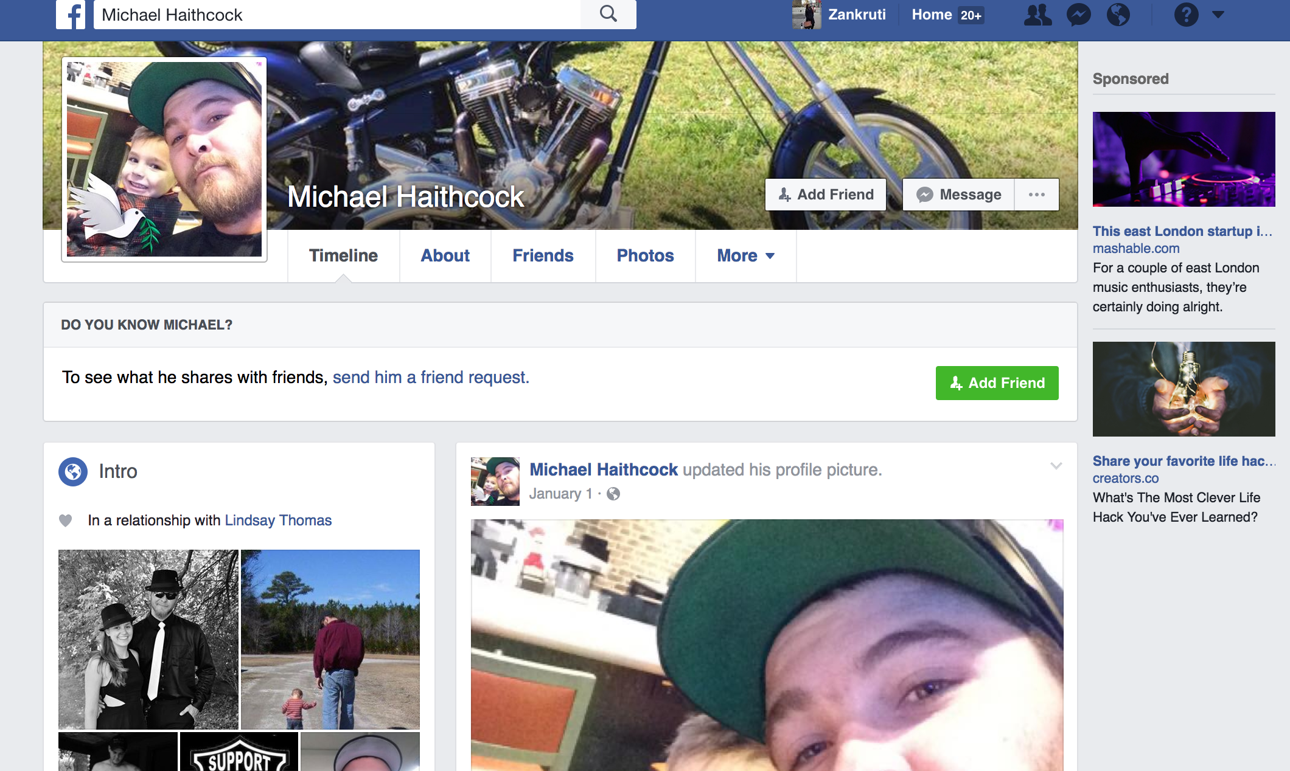

Slide 6
Prior report
In 2010 – SlashDot
In 2012 - https://www.youtube.com/watch?v=TG3kByB8EIE
In 2013 - Online Privacy Blog

Slide 7
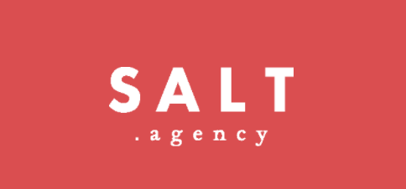
Who was involved and Impacted
Directly
Facebook
Reza Moaiandin
Technical Director - Salt.Agency
Software Engineer – Blog writer
Indirectly
Unidentified Users

Slide 8
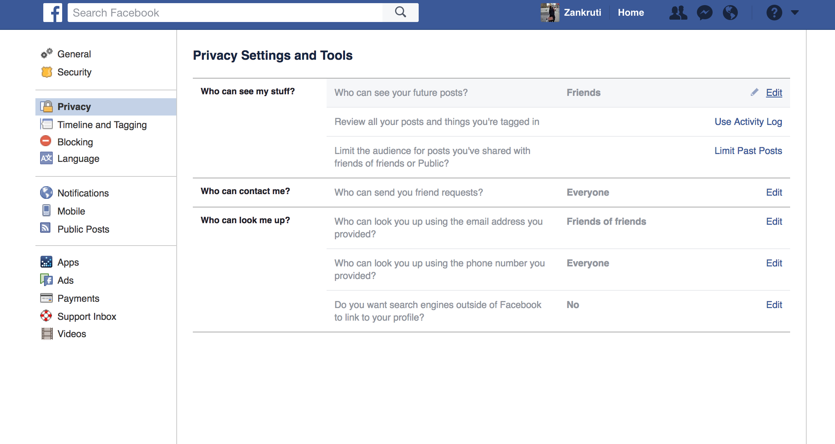
What happened?
Date : August 2015
Extraction of data from Facebook using Mobile number
Data : Names, locations, Images
Who can find me? -- Reverse Search

Slide 9
What happened?
Step 1:
Generated thousands of mobile numbers using simple algorithm.
Step 2:
Sent it to Facebook’s application programming interface – GraphAPI
The Graph API is the primary way to get data out of, and put date into Facebook's platform.
It's a low-level HTTP-based API that you can use to programmatically query data, post new stories, manage ads, upload photos, and perform a variety of other tasks that an app might implement

Slide 10
More on Facebook GraphAPI
nodes - basically "things" such as a User, a Photo, a Page, a Comment
edges - the connections between those "things", such as a Page's Photos, or a Photo's Comments
fields - info about those "things", such as a person's birthday, or the name of a Page
Object IDs
Each node has a unique ID which is used to access it via the Graph API.
GET graph.facebook.com /{node-id}

Slide 11
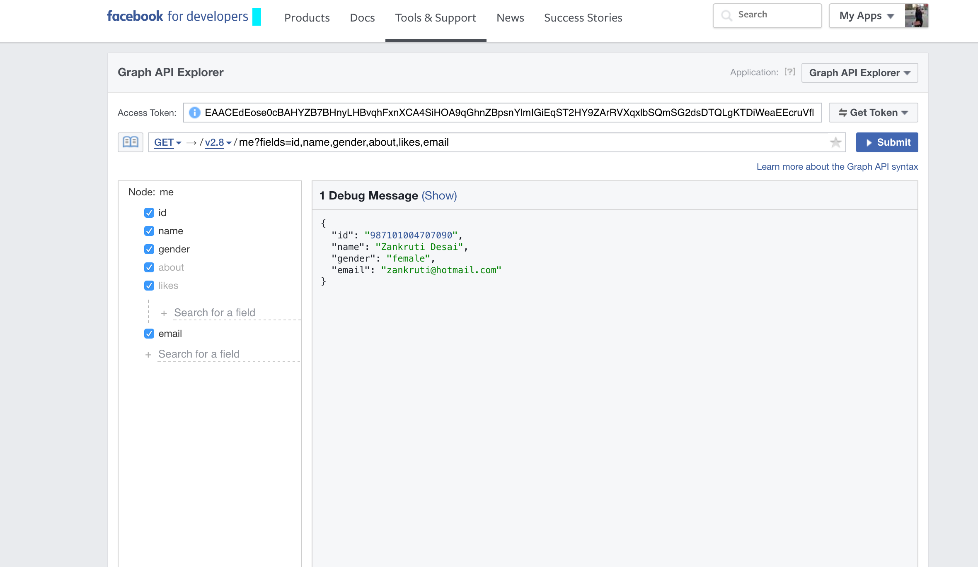
GET graph.facebook.com /{node-id}
me?fields=id,name,gender,about,likes,email

Slide 13
What makes it a privacy incident?
User details were extracted – Mostly public
Mobile Numbers as the source for extraction.
Link between the mobile number and user could be established.
Exposed to hackers – Create Large databases sold it to black market.

Slide 14
Follow-up?
Reza informed Facebook about the problem through Facebook’s bug bounty program in April.
Then again on 28th July 2015
Facebook’s employee statement : “We do not consider it a security vulnerability, but we do have controls in place to monitor and mitigate abuse.”
Focused more on restriction for developers on extracting bulk data through the API

Slide 15
Follow-up?
Two mail exchanges

Slide 16
Follow-up?
Reza suggested two possible methods for the problem:
To put a double layer encryption like Google and Apple.
User Id can be seen in JSON
Encrypt JSON so it can not be read during communication and then decrypt it later
Limit to extraction
How much data can a single user extract using Facebook’s API
July 2016 - Improving Rate Limits for Page Management Apps

Slide 17
Conclusion
Data on social media can never be fully protected.
If User wants to protect the data the best way is to not keep the data on any social media.
A data once shared would be accessible if public to hackers.

Slide 18
Questions?

